Slide 1
30 Day COPD Readmission Summit: The Duke Health Care System Model
Timothy Scialla MD
Assistant Professor
Duke Medicine
Division of Pulmonary and Critical Care
August 31, 2018

Slide 2
COI disclosure slide
Principle investigator for on-site clinical research trials sponsored by:
GSK
AstraZeneca
Sanofi
NHLBI
CME speaker for Pri-Med

Slide 3
Challenges abound!
? Identify target population while in hospital
Current state
Inaccurate hospital problem lists
Multiple co-morbid conditions
Unknown pulmonary function
Readmission rate (20%): Correlate w/ quality?
Administrative discharge diagnosis > Clinical diagnosis
20% discordance
Ideal state
Rapid identification of “at-risk” COPD population
Evidence-based focused interventions

Slide 4
ICD 9/10 Madness
“Do you feel more like a 490 or a 428? How about a J42._ J43._, or a J43._?”

Slide 5
Index COPD admission 2011-2012 Nguyen et al. Annals ATS. 2014
FEV 1% pred | 30-Day Readmission |  | Total Index (N= 4596) | P value
 | No (n= 3653) | Yes (n= 941)
 |  |  |  | 0.70
GOLD 1 | 307 (8%) | 69 (7%) | 376 (8%)
GOLD 2 | 879 (24%) | 235 (25%) | 1114 (24%)
GOLD 3 | 588 (16%) | 157 (17%) | 745 (16%)
GOLD 4 | 202 (6%) | 52 (6%) | 254 (6%)
Missing | 1677 (46%) | 430 (46%) | 2107 (46%)
14 medical centers Southern California (Kaiser Permanente)
Notes:
20% readmission rate

Slide 6
What are the proven interventions to decrease 30-day readmissions?
?

Slide 7
Current Practices at Duke Health Timeline: COPD Care Redesign Team
2014-2015:
Inpatient Management (↓ cost ↓LOS)
COPD admission orderset
Pulmonary consults for AECOPD (Navigator)
2016-2018:
Focus on transitions of care
Admission/Hospitalization/Discharge/Post Acute Care
COPD Navigator at DUH (August 2016)
COPD discharge clinic
Smoking Cessation Work Flow

Slide 8
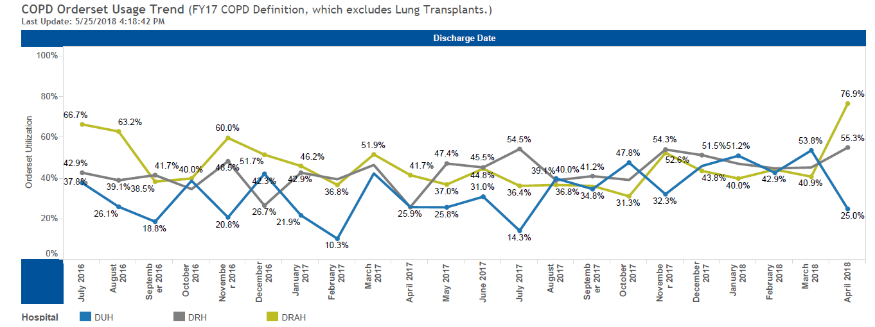
COPD Orderset Usage Trend
Notes:
Discuss Pulmonary consult failure: Really good idea to act as the Navigator and advocate/coordinate all follow up appointments and pulmonary rehab referrals

Slide 9
COPD discharge clinic
MONTHS 6-month intervals | Scheduled | No Show | No show %
2017 January-June | 11 | 2 | 18%
July-December | 52 | 13 | 25%
2018 January-June | 62 | 20 | 32%
Explanations
No ambulatory referral from inpatient orders
Poor messaging to inpatient teams on how to contact
Solutions
Incorporate scheduling into hospitalist workflow;
COPD navigator to schedule (only at DUH)
Dedicated APP to see all COPD discharge patients (Capacity 10/week)
Notes:
First 6 months of Discharge clinic: 9 patients
Made adjustments with HUB and COPD discharge language
Next 6 months: 15 seen of 29 scheduled at discharge
Next 6 months:

Slide 10
The COPD Navigator
Focus on patient assessment and education
Self-care
Medications
Need for oxygen or NIV
Smoking Cessation
Follow-up
Interface with Primary Team and Home Health
Patient advocate and coach

Slide 11
Re-admission Navigator vs the field Fiscal Year 2018
 | Total | 30-day readmissions
DUH w/ COPD Navigator | 94 | 12 (12.7%)
DUH w/o No Navigator | 201 | 30 (15%)
DRAH | 270 | 41 (15%)
DRH | 392 | 90 (11.7%)

Slide 12
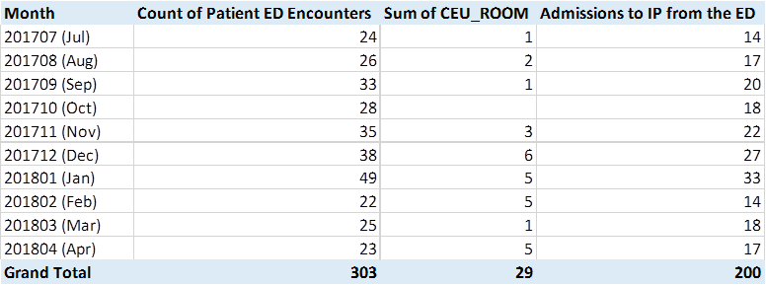
DUH ER experience: AECOPD

Slide 13
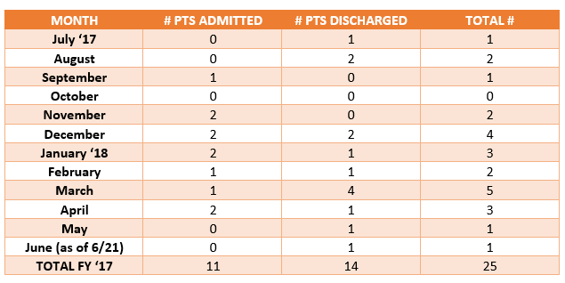
CEU COPD Disposition 2017

Slide 14
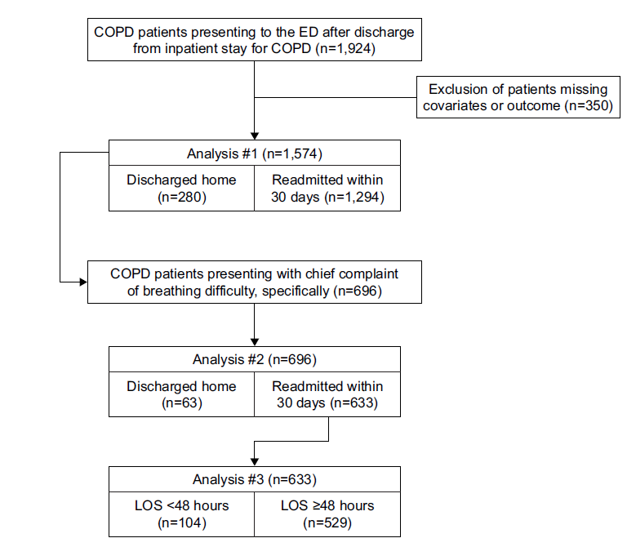
ER essentially equals re-admission Rezaee et al. International Journal of COPD. 2018
82%
91%

Slide 15
Future Directions
Better understand ER workflow for COPD patients
Better way to identify AECOPD on index admission
Risk tool for “high risk” patients (PEARL score?)
Confirm COPD with spirometry (? discharge day)
Make EPIC our friend not our enemy
Broaden COPD navigator role (inpatient + outpatient)
COPD discharge clinic: Recruit for clinical trials
Does any of this actually matter?

Slide 16
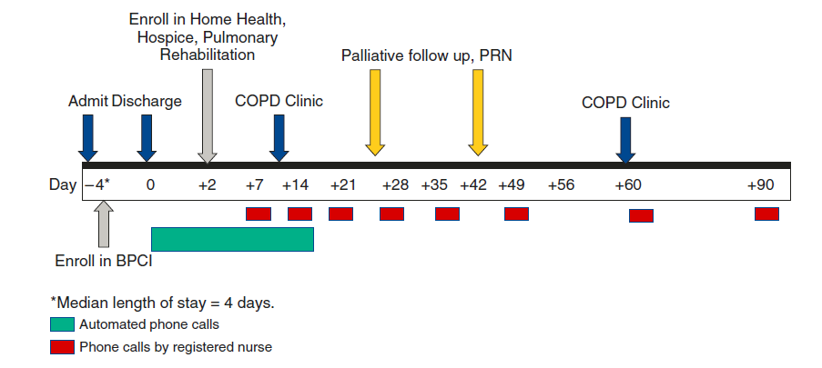
Bundled Payments for Care Improvement: “Value-based care?”
Bhatt et al. Ann Am Thorac Soc. 2017

Slide 17
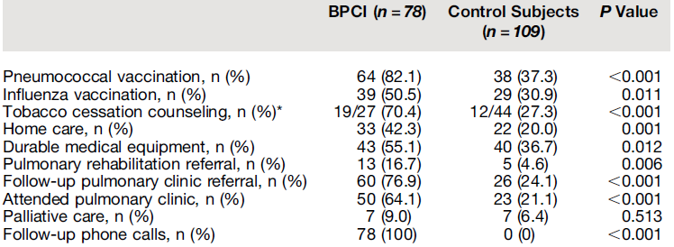
BPCI gets better care?
30-day all-cause readmissions (%) | 15.4% | 17.4% | 0.711
90-day all-cause readmission (%) | 26.9% | 33.9% | 0.224
Time to first admission (days) | 239 | 213 | 0.101
Bhatt et al. Ann Am Thorac Soc. 2017

Slide 18
1 year after hospitalization for AECOPD (death far too common)
 | Death
Characteristic | All N=1,283,069 | No ventilator %n | NIV %n | Invasive %n
Comorbidities CHF OSA Diabetes | 37.4 13.1 39.5 | 36.4 12.1 38.9 | 46.6 26.7 45.0 | 47.0 17.1 45.7
1-year mortality rate | 26.2 | 24.4 | 41.8 | 45.7
Lindenauer et al. AJRCCM. 2018

Slide 19
Never let a good crisis go to waste.
COPD Center of Excellence
Multidisciplinary opportunities
Personalized treatments for our patients
Opportunities for clinical research

Slide 20
Leverage talent of colleagues
Respiratory therapy
Oxygen titration/personalized oxygen prescriptions
Inhaler teaching
Inhaler vs nebulized therapy
Pulmonary rehabilitation
Innovative training programs/flexible schedule
Graduate program for Advanced COPD patients
Novel Imaging
CT
MRI
Non-Invasive ventilation in Hypercarbic COPD

Slide 21
Questions?

